Slide 1

HIV and periodic presumptive treatment of sexually transmitted infections in Papua New Guinea Christopher Rock John Murray and Richard Gray UNSW
Vacation Research Scholarships are funded jointly by the Department of Education and the Australian Mathematical Sciences Institute.

Slide 2
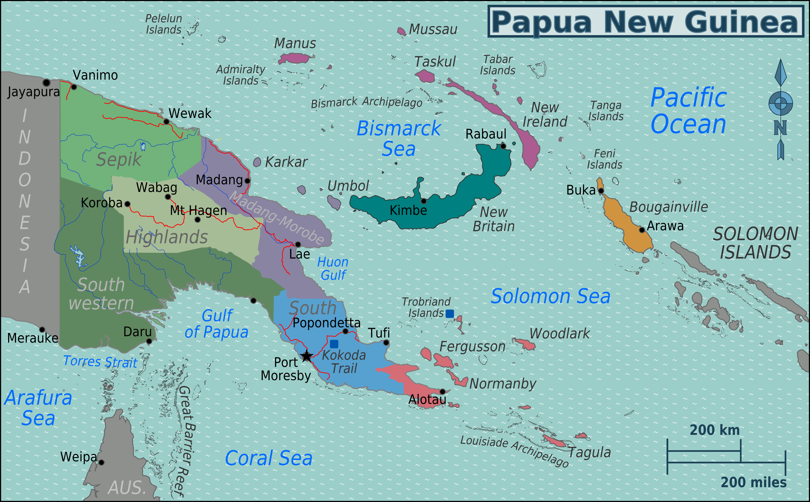
Project outline
Modelling project considering HIV in Papua New Guinea, and a possible treatment program called periodic presumptive treatment (PPT)
Image credit: Burmesedays, 2010. PNG Regions Map.
wikitravel.org/en/ Papua_New_Guinea

Slide 3
STIs and HIV
STIs and HIV
Levels of STIs
Syphilis: males 5.03, females 7.86, female sex workers (FSW) 31.14
Asymptomatic STIs
Source: Vallely, Andrew; Page, Andrew; Dias, Shannon; Siba, Peter; Lupiwa, Tony; Law, Greg; Millan, John; Wilson, David P.; Murray, John M.; Toole, Michael; Kaldor, John M. 2010. “The Prevalence of Sexually Transmitted Infections in Papua New Guinea: A Systematic Review and Meta-Analysis”, in PLoS ONE, Vol. 5 Issue 12

Slide 4
Periodic presumptive treatment (PPT)
Why PPT
What is PPT
Past experiences

Slide 5
Model approach
Build a model for STIs
Feed into existing model for HIV

Slide 6
Description of calibration stage
Two model runs (urban, rural)
Sub-populations (general females, FSW, general males, MSMW)
Proportions susceptible and infected
Calibrated to equilibrium

Slide 7
Prevalence equations
FSW
General females
General males
MSMW
Susceptible proportion:
Infection rate
Treatment and loss rate
Maximum infection rate
Infection level among males
Infected proportion:
Infection rate:

Slide 8
Intervention description
Structure of intervention scenarios
Frequency (6 visits/year, 12 visits/year)
Coverage (50% FSWs, 75% FSWs)
Will-receive-treatment and will-never-receive-treatment
Proportion protected by PPT

Slide 9
Prevalence equations with PPT
PPT rate
Recovery rate
Infection rate used in calculating and

Slide 10
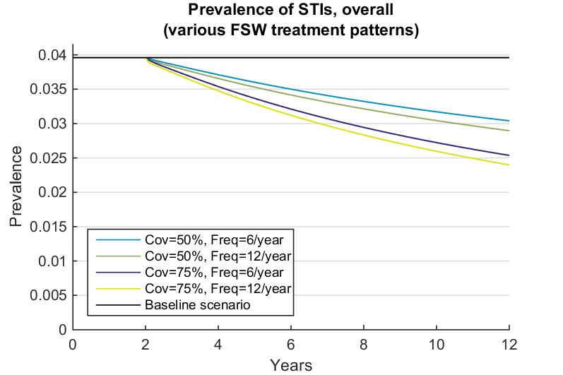
STI results

Slide 11
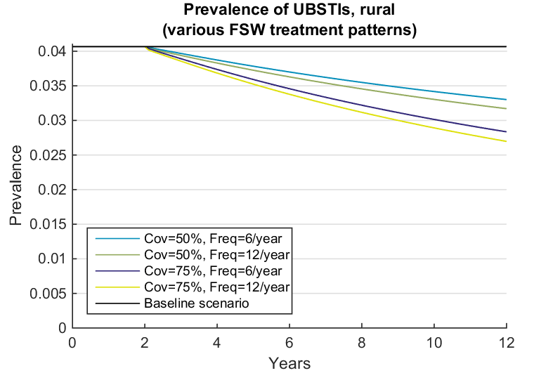
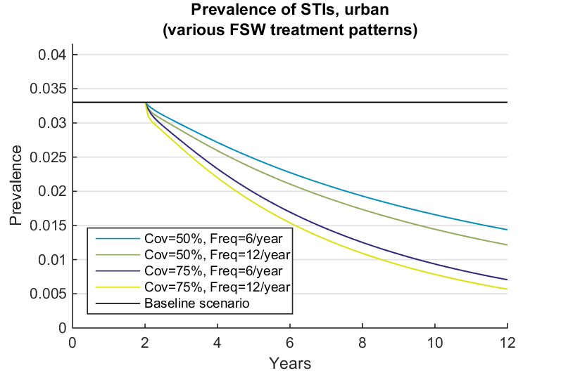
STI results – breakdown by region

Slide 12
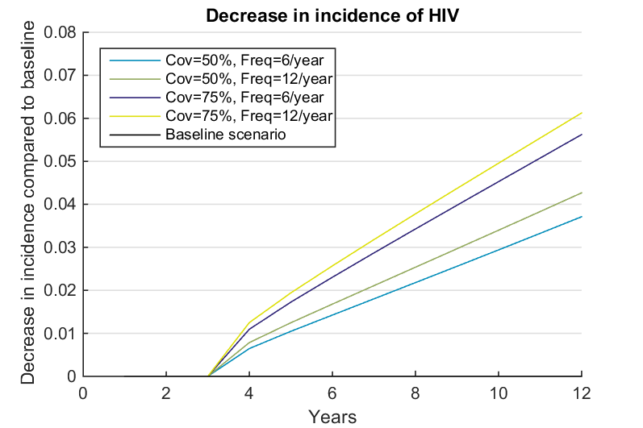
HIV results

Slide 13
Interventions into different populations
Target all males or all females with coverages of 20% or 30%, or target the whole population with coverages 10% or 15%
Achieve a similar effect with 25 times more people treated
Interventions targeting general population more sensitive to frequency than FSW
Combined intervention much less effective than either male or female intervention

Slide 14
Limitations and areas for further work
Model dependent on accuracy of data values and assumptions
Did not include uncertainty
Assumed homogenous mixing
Bridging populations
Modelling the spread of antibiotic resistance
The HIV model used comes from Gray, Richard T.; Vallely, Andrew; Wilson, David P.; Kaldor, John; MacLaren, David; Kelly-Hanku, Angela; Siba ,Peter; Murray, John M. 2014. “Impact of Male Circumcision on the HIV Epidemic in Papua New Guinea: A Country with Extensive Foreskin Cutting Practices”, in PLoS ONE, Vol. 9, Issue 8.
All modelling was performed using commercial the software package MATLAB® 8.4 (The MathWorks Inc., 2014).

Slide 15
Recommendations
PPT could be effective in PNG in wiping out some STIs in urban settings
PPT has moderate impact on HIV levels
A complete model is merited for informing a potential policy

Slide 16
Acknowledgements
I would like to thank the Kirby Institute and the UNSW School of Mathematics for their support for this project, the Department of Education for sponsoring this program,and the Australian Mathematical Sciences Institute for sponsoring and organising the program. They did all the really hard work to prepare for this event - the maths is the fun part!

